Slide 1
Learning Inductive Biases with Neural Networks
Reuben Feinman
Ph.D. Student, Neural Science
Research advised by Brenden Lake

Slide 2
Motivation: Efficient concept learning
Children can learn new concepts from just one or a handful of examples
“fork”
Adult: “this is a fork”
Notes:
We know they’ve captured the meaning because they generalize
e.g., black fork, silver fork, even this much larger thing that only has two prongs but similar form

Slide 3
The mapping problem
Fork == ???
Adult: “this is a fork”
Notes:
”fork” could mean things that are silver, or they could maybe mean things that are held in your hand in the kitchen

Slide 4
The mapping problem
Given a labeled example of a new word, how does the child construct a model of the word’s meaning?
Quine (1960): there is an infinite space of possible models that fit the child’s observations. Theory is underdetermined by the evidence.
But we know that a child can sort it out… (see, e.g., Bloom 2000)
How do they do it?

Slide 5
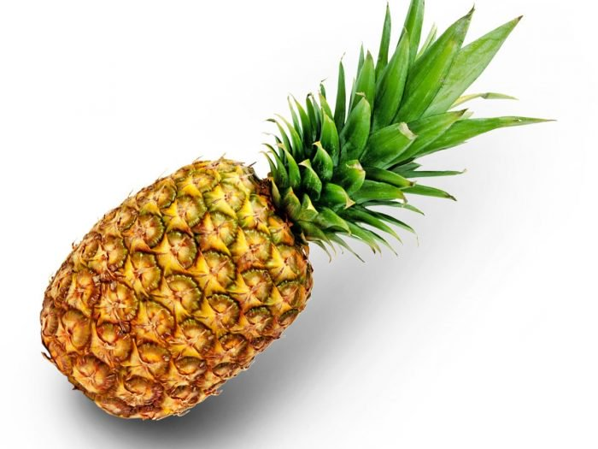
The importance of prior knowledge
Likely models under prior
When space of potential models is large and data is scarce, priors are needed to delimit model search space
e.g., when considering what characteristics are important for object naming
All possible models
“Pineapple”
“Hairbrush”
“Lightsaber”
Notes:
Model building as feature learning. What features are important? A prior will prefer certain categories of features over others.
In the cognitive science community, these model priors are referred to as “inductive biases”

Slide 6
The shape bias
Inductive bias (or model prior) possessed by children (Landau et al., 1988)
Important in early word learning
Children ages 2-3+ years most likely to select option 1
Notes:
Children who have learned their first few words possess the shape bias
Child is presented with an exemplar object of the category “dax”
Child is then presented with 3 query objects: one that matches in shape, one in color, and one in texture (material)
Child is asked to find the other “dax” from the 3 query objects

Slide 7
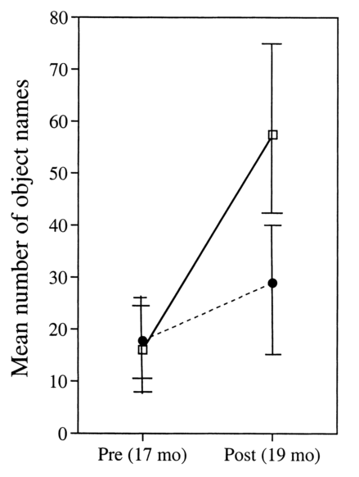
The shape bias
Child’s early noun vocabulary consists predominantly of shape-based categories (Samuelson & Smith, 1999)
Development of shape bias predicts the onset of vocabulary acceleration
Smith et al., 2002
Gershkoff-Stowe & Smith, 2004
Notes:
Child’s early vocab: there are a lot of “count nouns” which are typically object names like ball, fork, cup, etc.
Children learn to categorize object names according to shape. This bias helps with future word learning

Slide 8
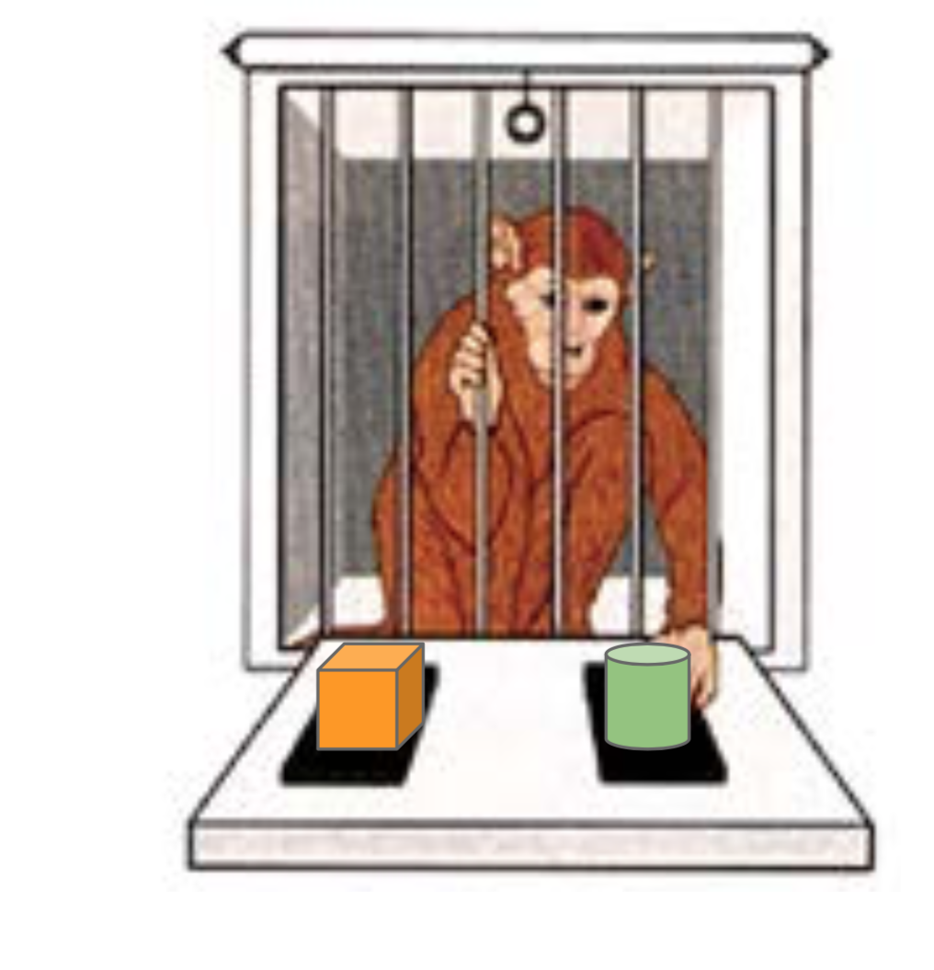
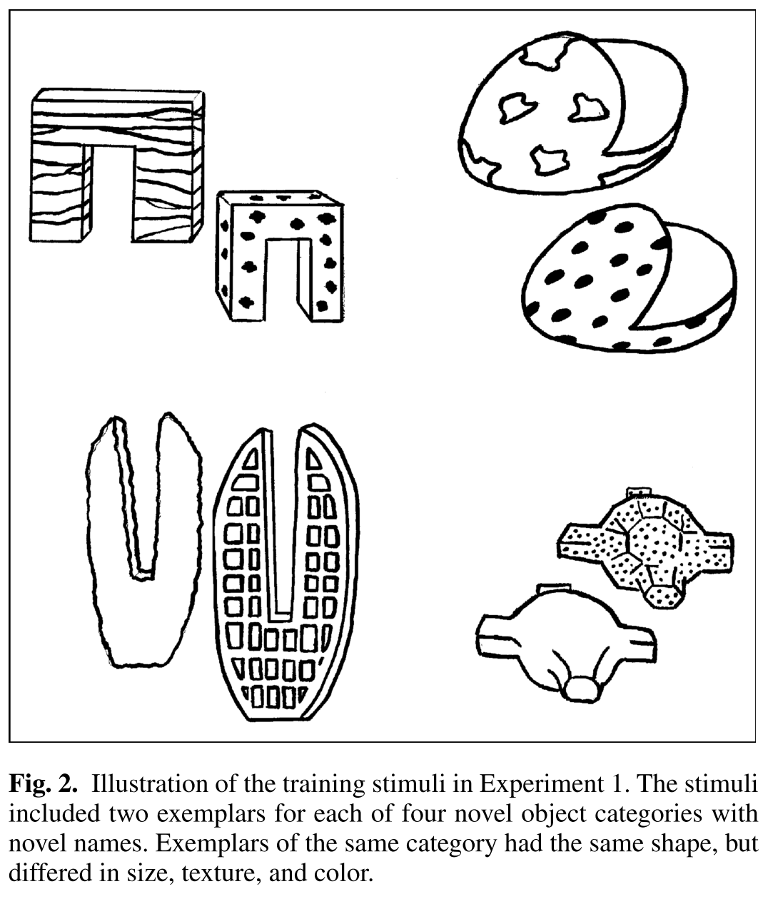
Learning inductive biases
Origin of inductive biases is not always clear
However, results show that children, adults and primates alike can “learn-to-learn” or form delimiting higher-order generalizations that improve the efficiency of future learning (Harlow, 1949; Smith et al., 2002; Dewar & Xu, 2010)
Harlow (1949) experiments with primates
Smith et al. (2002) experiments with human children
Notes:
Harlow experiment
- monkey has to choose between two doors, one of which had food
- one unique object on each door
- for each session, the monkey guesses a door 6 times
- each time, the food location is random, but it’s always associated with a certain object
- rate of improvement across the 6 trials increases over time; monkey develops inductive bias that object correlates with food location

Slide 9
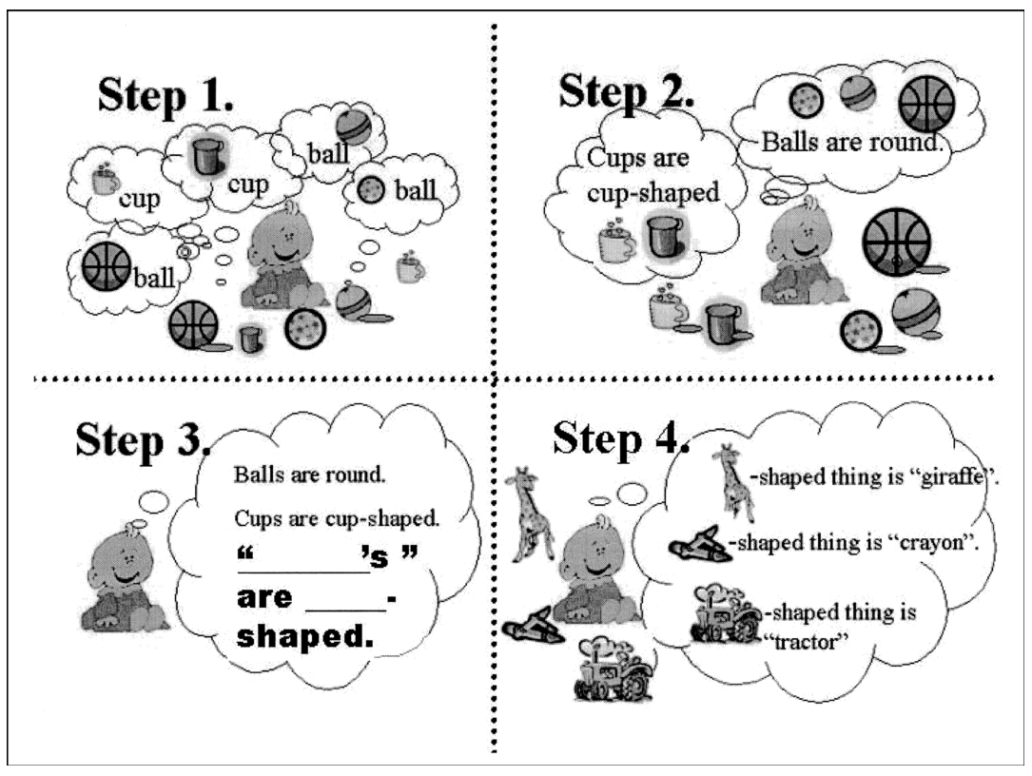
Learning the shape bias
Hypothesis of
Smith et al. (2002)
Notes:
Step 1: the child comes across a bunch of objects, and is taught the names of those objects
Step 2: the child learns the first-order generalization – namely, that objects of the categories she has seen are organized according to their shape
Step 3: the child learns the second-order generalization – namely, that objects in general tend to be categorized according to shape. She has now acquired the shape bias.
Step 4: the child has now acquired the shape bias, and this inductive bias leads to rapid acquisition of new words

Slide 10
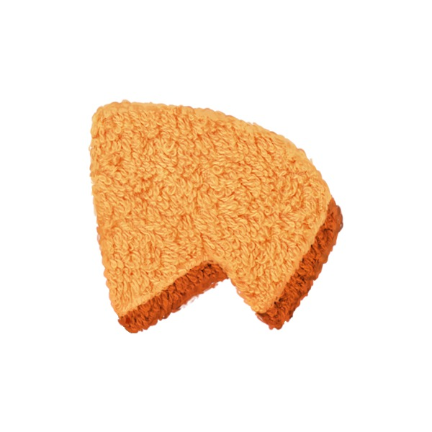




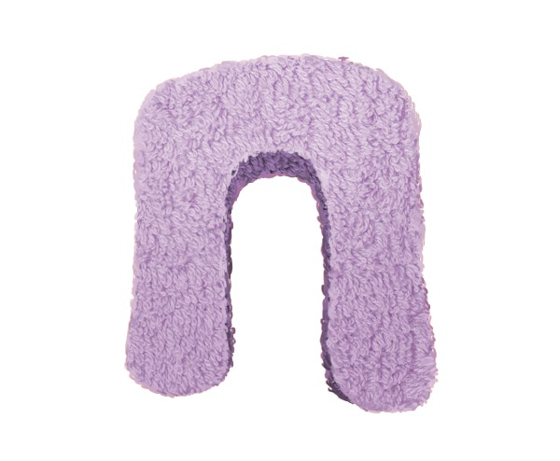
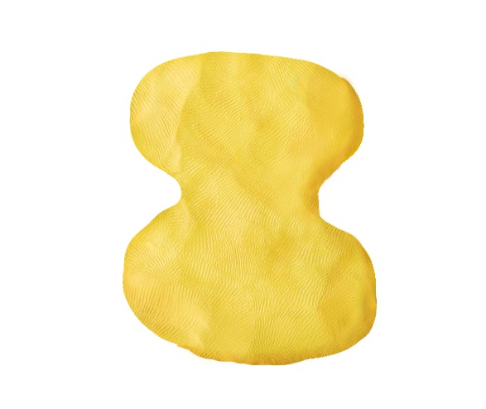

Learning the shape bias
Smith et al. (2002) used a synthetic training environment to guide toddlers to the shape bias over 9 weeks
Toddlers taught 4 object words during weekly play sessions
“wif”
“zup”
“lug”
“pep”
Notes:
Every object was assigned a particular shape, color and texture
Object names categorized exclusively by shape

Slide 11
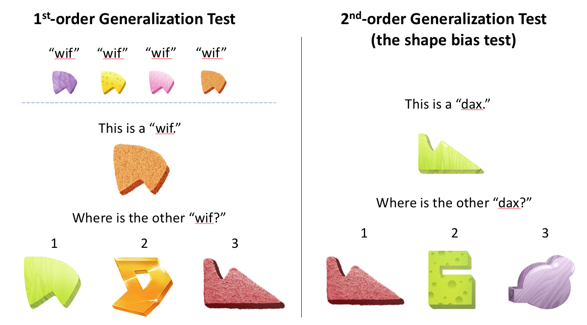
Learning the shape bias: evaluation
Notes:
At each weekly session, toddlers evaluated on 2 tests
1st order test: toddler is shown an exemplar that she saw during training, asked to find the other (novel) example of that category
2nd order test: toddler is shown a novel exemplar of a novel category, asked to find the other example of that category

Slide 12
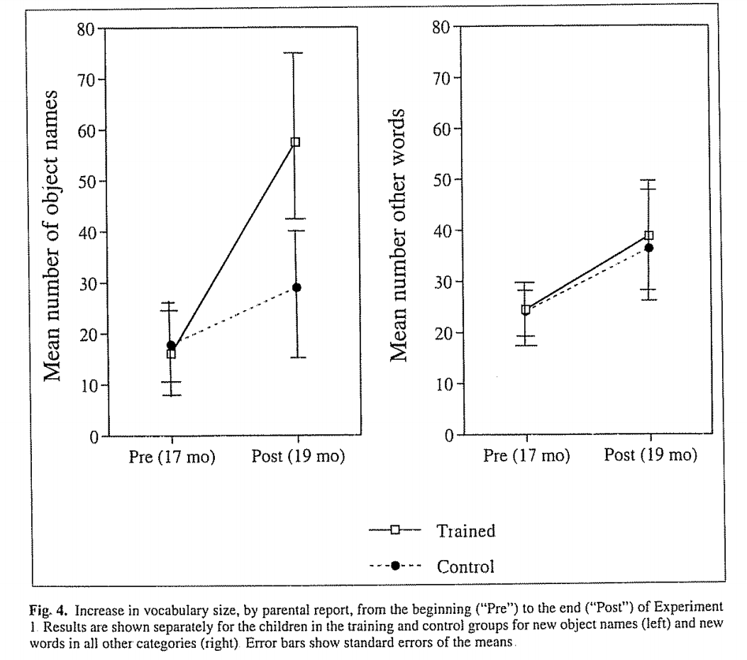
Learning the shape bias: evaluation
Children learned to generalize by shape 88% in the 1st-order test and 70% in the 2nd-order test (shape bias test). Control group achieved 34% on 2nd-order.
Shape training group showed significant increase in rate of object name acquisition

Slide 13
Learning the shape bias: computational models
Do we have models that can explain how these higher-order generalizations are acquired?
What is the required sample complexity to acquire these biases?
How does bias acquisition relate to word learning?

Slide 14
Learning the shape bias: computational models
Colunga & Smith (2005) used a simple RNN trained with Hebbian learning to learn the shape bias
  Stimuli presented as abstract patterns of bits
  100 examples of 10 object categories used to train
Kemp et al. (2007) used a Hierarchical Bayesian Model (HBM) trained with 2 examples of 4 object categories
  Note: it is difficult to apply these models to raw data without significant hand-engineering
Ritter et al. (2017) showed that ImageNet-optimized CNNs show the shape bias
Notes:
Colunga & Smith do not systematically alter the quantity and form of the data presented, so we don’t know the exact conditions required to develop this bias
HBMs: it is difficult to apply these models to the type of high-dimensional visual and auditory stimuli that children receive without significant hand-engineering
Ritter et al. used probe images of simple objects similar to those used in Smith et al.

Slide 15
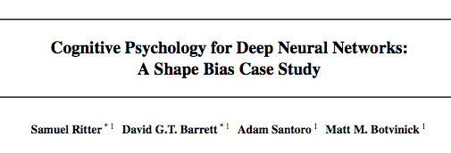
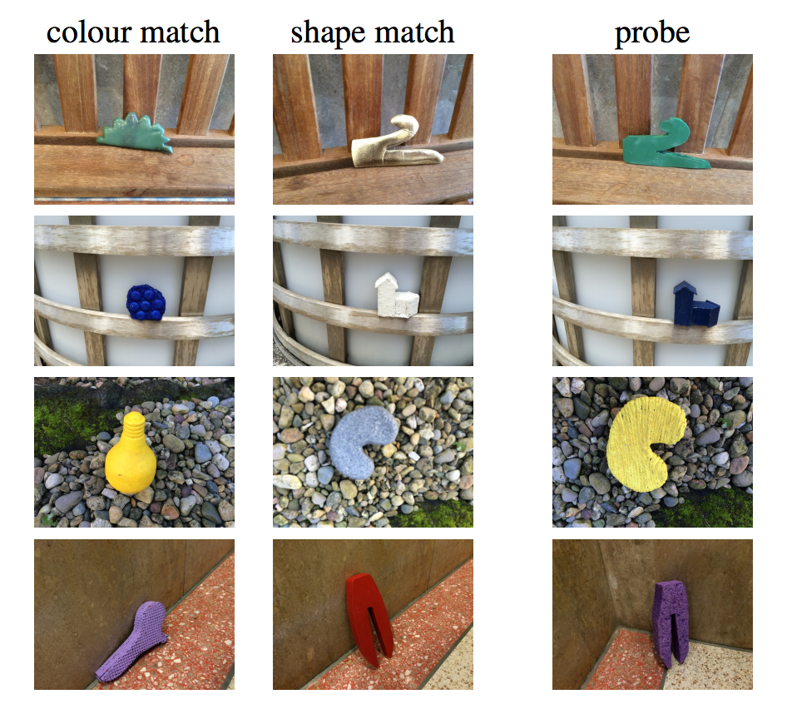
Learning the shape bias: computational models
Inception (Szegedy et al., 2015) and Matching Nets (Vinyals et al., 2016) used
Cosine similarity of last hidden layer
Inception shape bias = 0.68, Matching Nets shape bias = 0.70
But these models are trained with ~1200 examples of 1000 object categories…

Slide 16
Our experiments
Goal: use purified shape training similar to Smith et al. (2002), analyze sample complexity required for NN to learn the shape bias
Begin with simple bit-vector data (MLP), then try color images (CNN)
Train with various sized training sets, varying both the # categories and the # examples per category
Evaluate shape bias development with 1st- and 2nd- order tests
  Create evaluation trials containing exemplar object, a shape match, a color match, and a texture match
  Obtain activation of last hidden layer for each object
  Evaluate cosine similarity between exemplar’s activation and each match type’s to identify network choice
  Repeat for N trials, compute % shape choices
Notes:
Train neural networks to label objects with category names based on shape
Evaluation sets use novel shapes, colors and textures

Slide 17
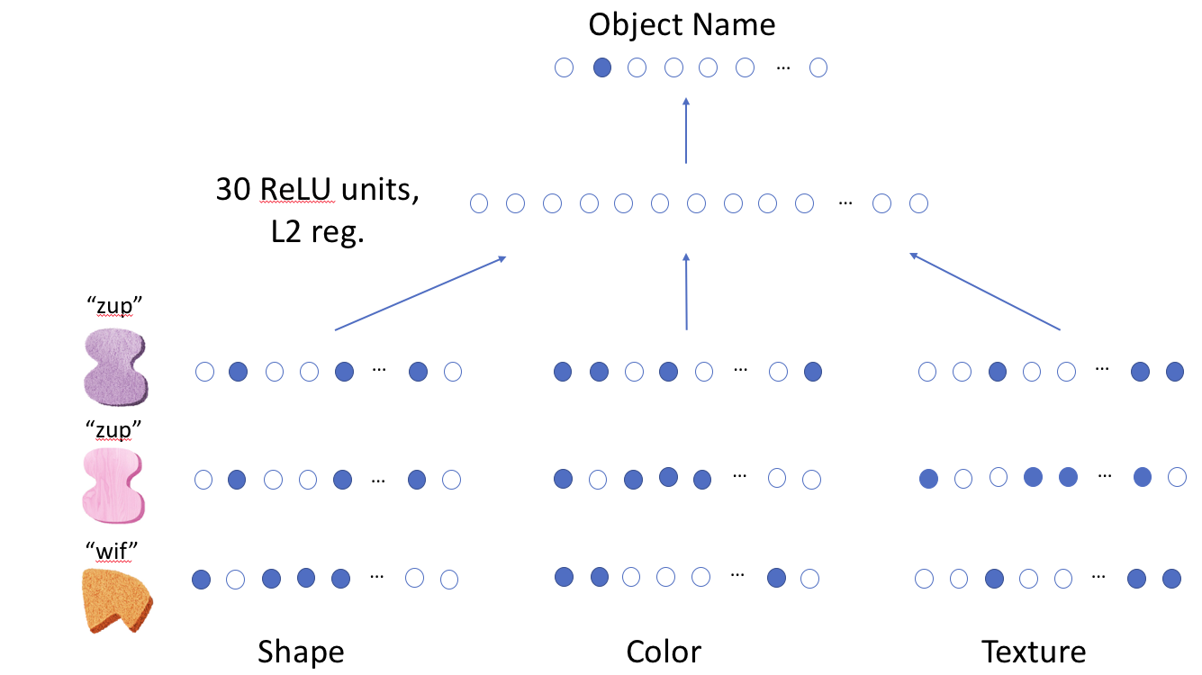
Experiment 1: Multilayer perceptron trained on synthetic objects
Figure 3: Multilayer perceptron architecture. Shape, color and texture attribute vectors are concatenated and fed to a 30-unit hidden layer, followed by a classification layer. 3 example input objects are shown (only one is presented at a time to the network).
Notes:
TODO: explain model architecture
After random initialization, the model selects by shape 35%, 33% color and 32% texture

Slide 18
Experiment 1: Multilayer perceptron trained on synthetic objects
0.71
0.80
Results: network breaks threshold (0.7 acc on 2nd-order test) @ 4 categories, 3 examples (0.80) and @ 2 categories, 6 examples (0.71)
Nears sample efficiency of the toddlers, who use 4 categories and 2 examples to achieve 0.7 acc
Notes:
1000 trials used for both the 1st and 2nd order tests. Results show average from 10 training runs
Notably, success in the 1st-order generalization requires fewer data than 2nd-order generalization, consistent with the hypothesis of Smith et al.
Recall that Colunga & Smith (2005) used 100 examples of 10 categories to train their network; it turns out a simple NN can learn the shape bias from much smaller data
HBM used 4 categories and 2 examples

Slide 19
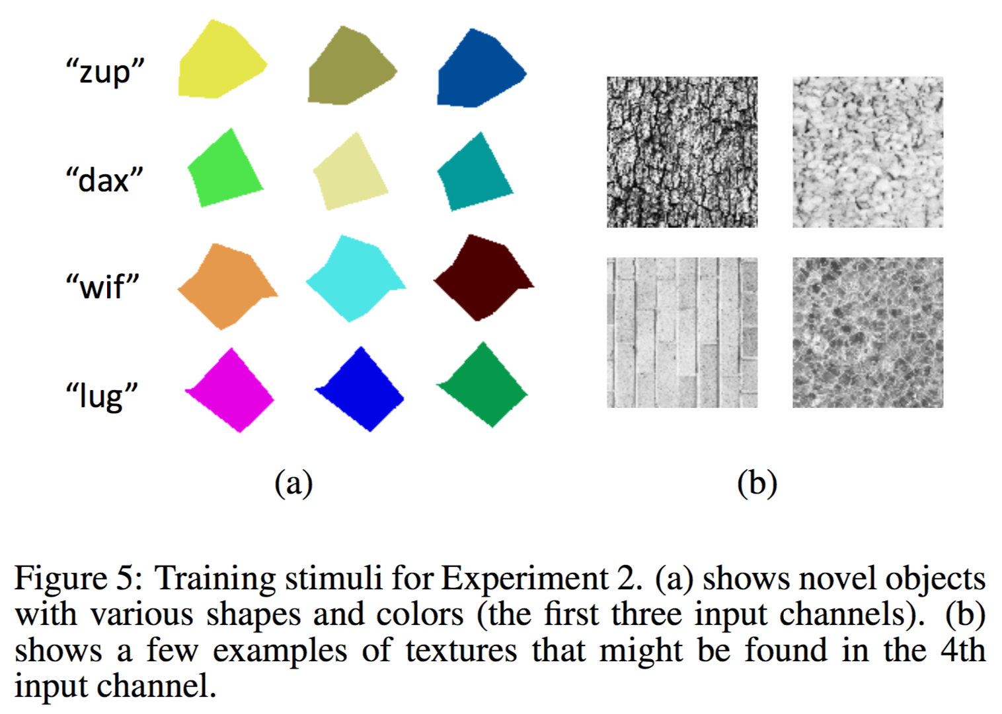
Experiment 2: Convolutional network trained on synthetic objects
Objects represented as color images
Object shapes are polygons of random order (uniform 3-10)
Colors selected to span RGB space with equal spacing
Texture is presented in a 4th channel, independent of RGB space
Notes:
Idea: increase stimulus complexity, since NNs can learn effectively from data in raw and complex forms
Texture presented in 4th channel because children… TODO
Textures from the Brodatz texture library used

Slide 20
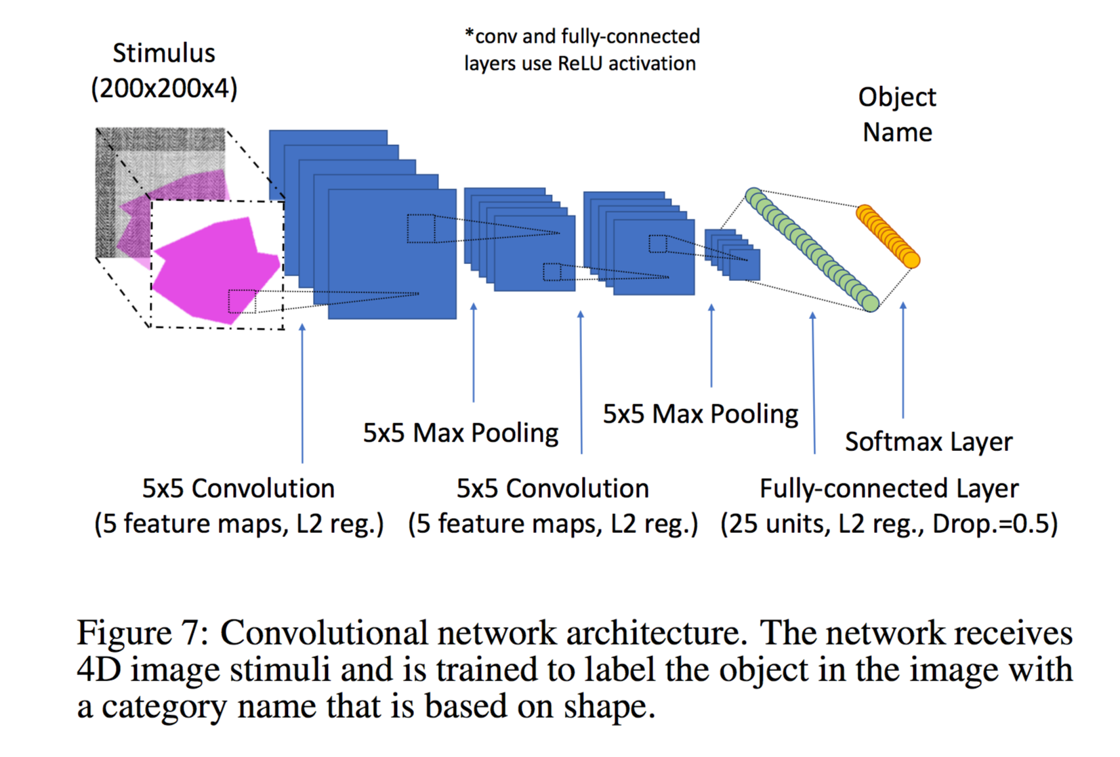
Experiment 2: Convolutional network trained on synthetic objects
Notes:
TODO: explain model architecture
After random initialization, the model selects by shape 38%, 42% color and 20% texture

Slide 21
Experiment 2: Convolutional network trained on synthetic objects
0.70
0.75
Results: network breaks threshold @ 8 categories, 6 examples (0.75) and @ 4 categories, 12 examples (0.70)
Takeaway: with concentrated training effort, it’s possible to learn the shape bias from small data using high-dimensional color images
Notes:
Again we see that success in the 1st-order generalization requires fewer data than 2nd-order generalization
Ritter et al. (2017) left open the question of whether a CNN trained on color images could learn the shape bias from just a few examples of a few categories. Here, we’ve confirmed that it is possible.

Slide 22
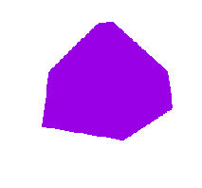
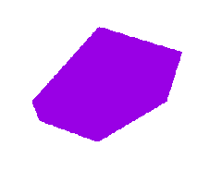







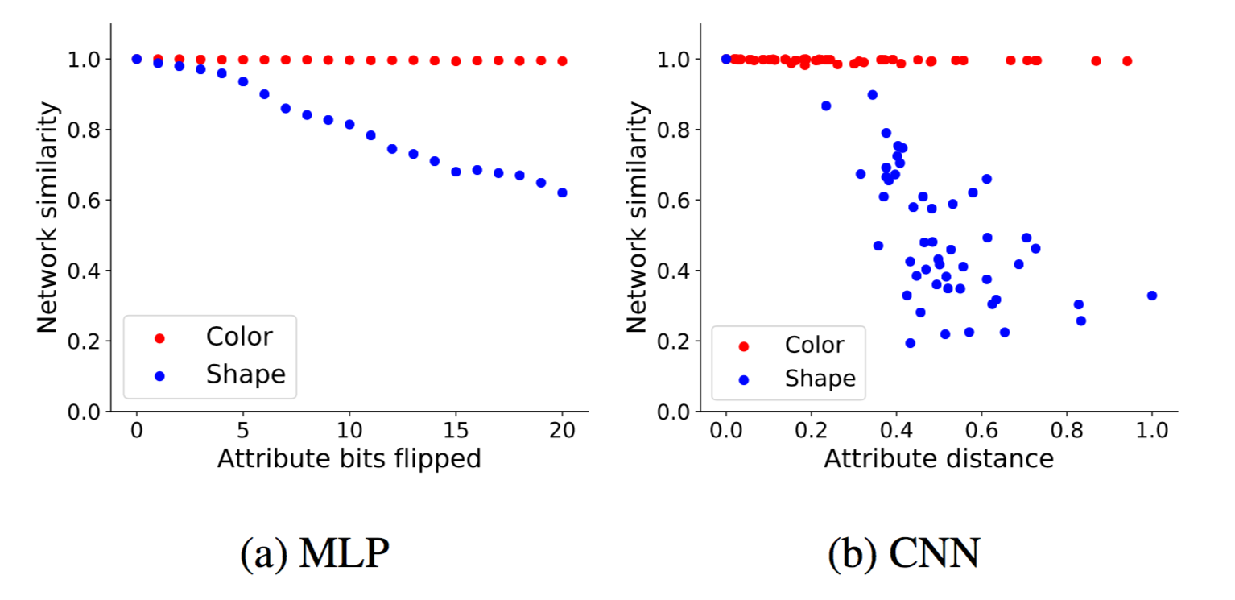
Perceptual sensitivity tests
Distance along stimulus dimension
Idea: parametrically vary the input along a particular stimulus dimension, measure perceptual distance from original
Use network trained with purified shape training
Original
Shape
Color
Notes:
Chose training set size so that network shows high (>= 0.9) shape bias
For MLP, stimulus distance is the # of bits flipped
For CNN, shape distance is computed using Modified Hausdorff Distance (normalized to 0-1). Color distance is Euclidean distance in RGB space
Clearly, the networks are much more sensitive to changes in shape than color

Slide 23
Experiment 3: The onset of vocabulary acceleration
Previous experiments show that simple NNs can learn the shape bias from few examples
Remains unclear, however, how the dynamics of shape bias acquisition relate to the dynamics of word learning
Gershkoff-Stowe & Smith (2004) showed that the development of the shape bias in toddlers predicts the onset of vocabulary acceleration during early word learning
  8 toddlers studied during regular lab sessions at 3-week intervals
  Shape bias assessed at each session, and child’s vocabulary logged
  Correlation found between shape bias strength and rate of increase in vocabulary size

Slide 24
Experiment 3: The onset of vocabulary acceleration
Designed new CNN experiment with goal of computing analogous correlation metrics
Participants of Gershkoff-Stowe & Smith (2004) received natural experience in home setting. Thus, rather than purified shape training, we train CNN to simultaneously label shape, color and texture
# of categories along each label dimension, and loss weight for that dimension, are determined according to natural statistics of early human lexicon
Chosen ratios: 60-20-20 shape-color-texture

Slide 25
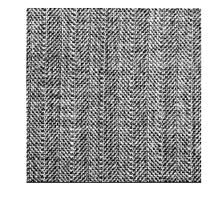


Experiment 3: The onset of vocabulary acceleration
Stimulus
(200x200x4)
*conv and fully-connected layers use ReLU activation
Object Name (shape)
Loss weight: 0.6
Color Name
Loss weight: 0.2
Texture Name
Loss weight: 0.2
5x5 Max Pooling
5x5 Max Pooling
Softmax Layer(s)
5x5 Convolution
(5 feature maps, L2 reg.)
5x5 Convolution
(5 feature maps, L2 reg.)
Fully-connected Layer
(25 units, L2 reg., Drop.=0.5)

Slide 26
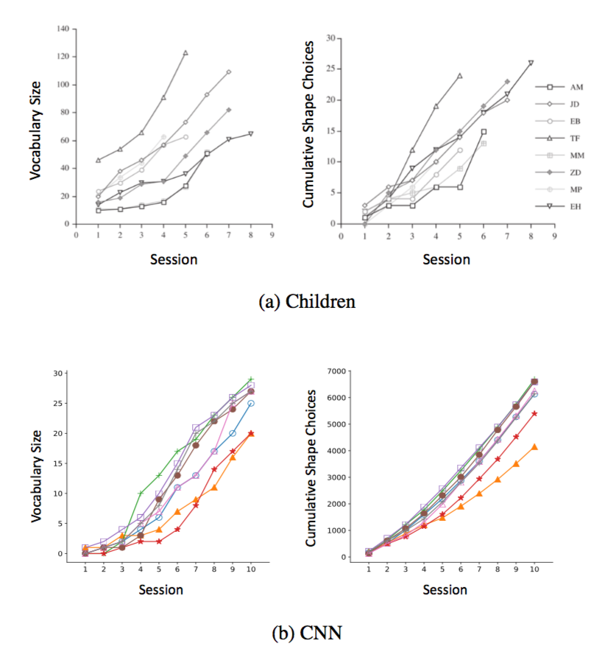
Experiment 3: The onset of vocabulary acceleration
Looked at first 30 training epochs (“early” word learning period - model learning has not yet flattened out)
Divided period into 10 “sessions” of 3 epochs
Correlation 1 & 2
Notes:
Vocabulary size is cumulative # of shape categories for which the network has achieved 80% or greater acc on training set
Cumulative shape choices: cumulative # of times the shape match was chosen by our networks (1500 trials per session)

Slide 27
Experiment 3: The onset of vocabulary acceleration
 | Toddlers | CNN
Correlation 1 | 0.75 | 0.53
Correlation 2 | 0.81 | 0.76
Dynamics of shape bias acquisition and early word learning considerably correlated
Notes:
Takeaway: dynamics of shape bias acquisition and early word learning show a considerable dependency on one another in our CNNs

Slide 28
Conclusions
Using controlled synthetic experiments, we’ve determined precise quantities of data required for NNs to learn the shape bias
Simple MLPs can learn shape bias from stimuli presented as abstract patterns with as few as 3 examples of 4 object categories
Simple CNNs can learn shape bias from stimuli presented as color images with as few as 6 examples of 8 object categories
Network’s sensitivity to shape varies parametrically with the input
Development of the shape bias is correlated with accelerated word learning

Slide 29
Future Work
Findings suggest that it may be possible to train large-scale image recognition models more efficiently after initializing these models with shape bias pre-training
In future work, we will investigate this hypothesis with ImageNet-scale CNNs, using an initialization framework designed after these experiments

Slide 30
Thank you!
Feinman, R., & Lake, B.M. (2018). “Learning Inductive Biases with Simple Neural Networks.” arXiv preprint arXiv:1802.02745.
Code: https://github.com/rfeinman/learning-to-learn
Many thanks to Brenden Lake
http://www.cns.nyu.edu/~reuben/
Notes:
Can also access these slides on my website under “Talks”

