Slide 1
SK-reg: Learning a smooth kernel regularizer for Convolutional Neural Networks
Reuben Feinman
Research advised by Brenden Lake

Slide 2
Background: Convolutional Neural Networks
From LeCun, Bengio & Hinton (2015)
Notes:
-CNNs are a feed-forward NN architecture that process color images
-each image is composed of a red, green and blue channel
-CNNs process images with a cascade of convolution operations, each typically followed by a pooling operation

Slide 3
Motivation
Convolutional neural networks (CNNs) have high representational capacity, but they require tremendous amounts of data
With well-designed priors, or inductive biases, we can help CNNs take a step towards human-like sample complexity

Slide 4
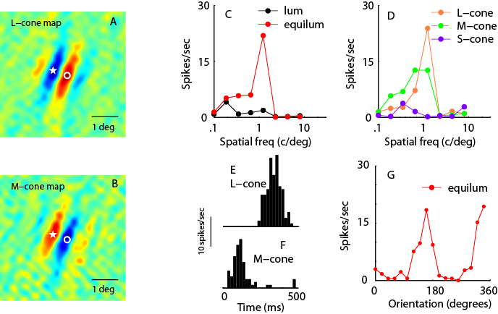
Kernel priors
The learned convolution kernels of CNNs contain substantial structure, and they have parallels to primary visual cortex
We aim to capture some of this structure in a kernel “prior”
AlexNet layer-1 kernels
Simple cell receptive field
(Krizhevsky et al. 2012)
(Johnson et al. 2008)
Notes:
-The linear filters of each convolution are typically referred to as "kernels"
-As I mentioned, they filter the image patch by patch
-Here, showing the 1st-layer convolution kernels of AlexNet
-Also showing an example of a simple cell receptive field recovered from electrophysiological recordings in monkeys
-our goal was to try and capture some of this structure with a "kernel prior"... by enforcing this structure a priori, we don't need to rely quite as much on the data... our thought was that this might enable us to learn from just a few examples

Slide 5
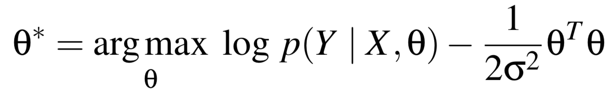
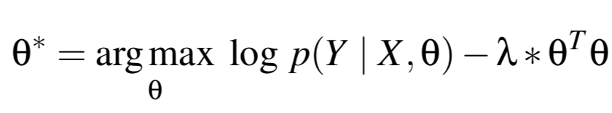
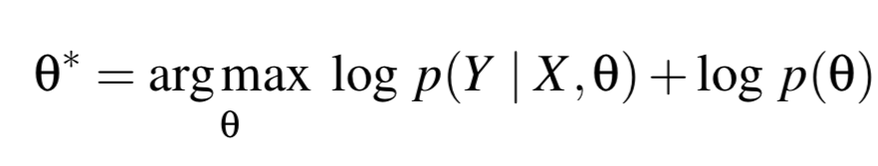
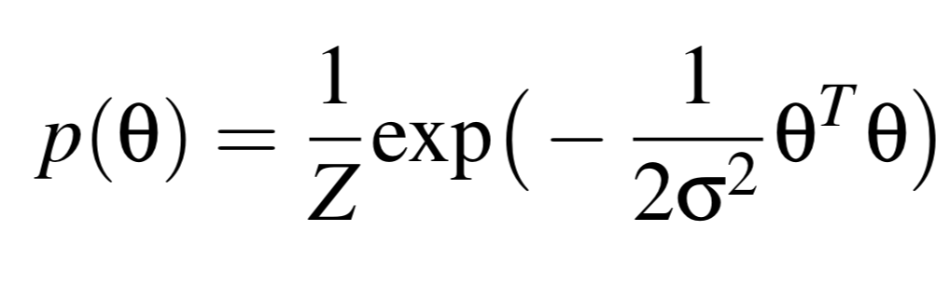

Kernel priors
Key
: training images
: training labels
: CNN weights
prediction accuracy
regularization penalty
L2 objective:
(1)
log-likelihood
log-prior
Bayes’ rule
MAP:
*equivalent to Eq. (1) for appropriate $λ$!
Notes:
-The simplest kernel prior is one you may already be familiar with
-L2 weight regularization can be interpreted as placing a zero-mean, i.i.d. Gaussian prior over the kernel weights
-Here, I’ll review the connection
-The L2 objective is to find the \theta that maximizes prediction accuracy while minimizing the regularization penalty
-prediction accuracy for a CNN is the categorical cross-entropy; i.e. the log-probability of the correct class
-Data likelihood: given some set of model parameters \theta, how well does our model fit the data?

Slide 6
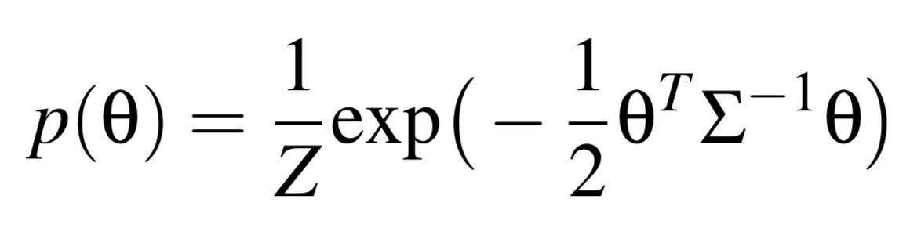
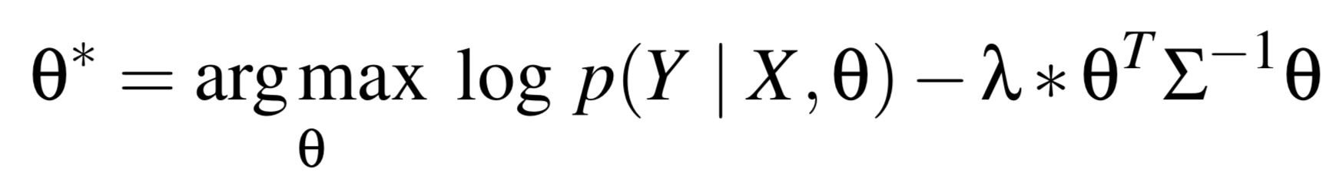
Kernel priors
SK-reg: add correlation
Correlation enables the prior to model structure in the kernels, like smoothness
Notes:
-The idea with SK-reg, which is the term that we use for our prior that we introduce, is to add correlation
-Still using zero mean, like L2

Slide 7
IID v.s. correlated Gaussian
Notes:
-Demonstration:
-here, we show samples from an i.i.d. Gaussian fit to the layer-1 kernels, and also a correlated Gaussian
-a correlated multivariate Gaussian is able to capture structure in the learned kernels, like smoothness
-an i.i.d. Gaussian misses this structure

Slide 8
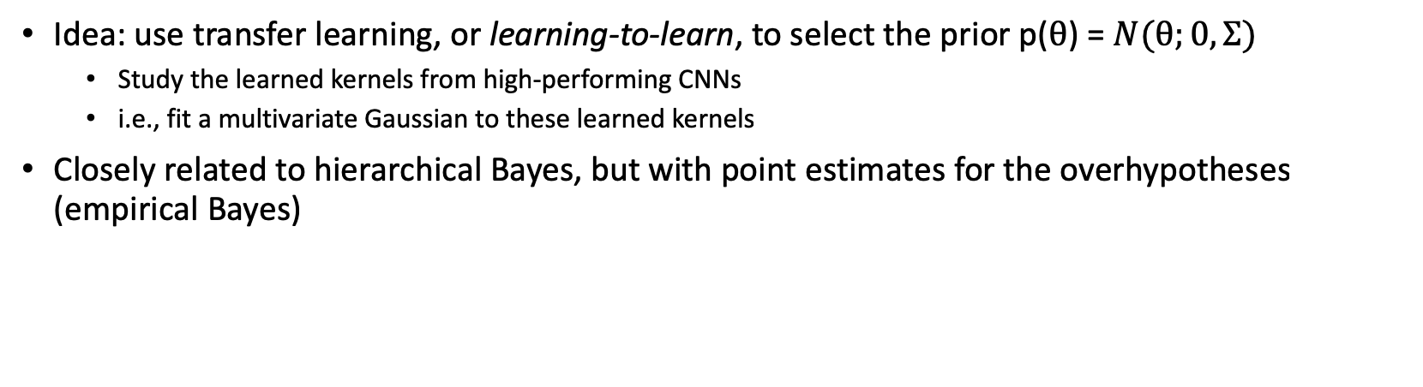
Learning kernel priors
Idea: use transfer learning, or learning-to-learn, to select the prior p($θ$) = $Ν(θ;0,Σ)$
  Study the learned kernels from high-performing CNNs
  i.e., fit a multivariate Gaussian to these learned kernels
Closely related to hierarchical Bayes, but with point estimates for the overhypotheses (empirical Bayes)

Slide 9
Learning kernel priors
Notes:
We’re calling our new correlated regularizer “SK-reg,” a.k.a. smooth kernel regularizer

Slide 10
Phase 1 training
Image classes
CNN architecture

Slide 11
Phase 2 training
L2:
SK:
Results
(test set)
Notes:
-Regularization weight (lambda) is selected for each method via validated grid-search
-Average results are shown from 10 training runs with each regularization method
-SK-reg improves average test accuracy by roughly 55%

Slide 12
ImageNet test
Can the priors learned from phase 1 training generalize to a new image domain?
Test: perform phase 1 training with silhouette images, apply the resulting priors to ImageNet classification*
Notes:
-Explain that we’re only using a subset of 10 well-structured ImageNet classes (10-way classification)
-Explain that we’re using the same CNN architecture
-Explain that we made a slight modification to the silhouettes in phase 1 training

Slide 13
ImageNet test
Results
(test set)
Notes:
-Regularization weight (lambda) is again selected for each method via validated grid-search
-Average results are shown from 10 training runs with each regularization method
-SK-reg improves average test accuracy by roughly 8%

Slide 14
Summary
SK-reg enforces correlated a priori structure on convolution kernels
  This structure is determined via transfer learning
It can yield up to 55% performance improvement over L2 in low-data learning environments
It can generalize to novel image domains with distinct statistics

